Slide 1


Mapping Omics datasets on KEGG Metabolic Pathways
Master's Project in Bioinformatics
Duarte Alves Velho
May 2024
Under the guidance of:
Andreia Salvador;
João Sequeira

Slide 2
State of the Art
Omics and meta-omics technologies are powerful approaches for exploring the functions of microorganisms;
software developed for omics and meta-omics analysis is a valuable resource for analysis;
Visualizing the results in pathways allows for a greater understanding of biological processes, particularly in MT experiments where different genes/proteins and pathways are differentially expressed, but there are not many resources to do so;
There are several bioinformatics resources for meta-omics analysis, but many of them require significant computational expertise.

Slide 3

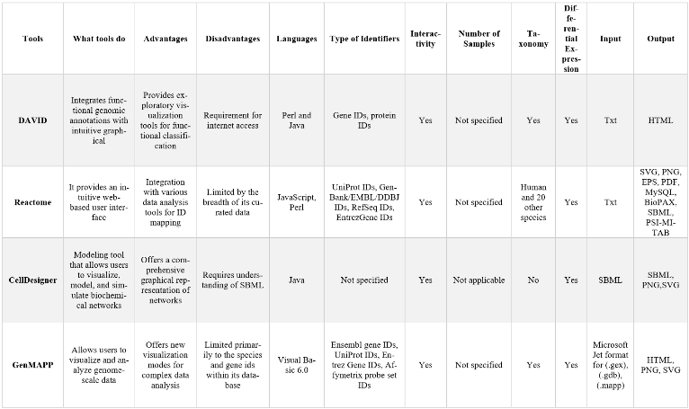
Fig. 1 - Example of tools that map metabolic pathways.

Slide 4
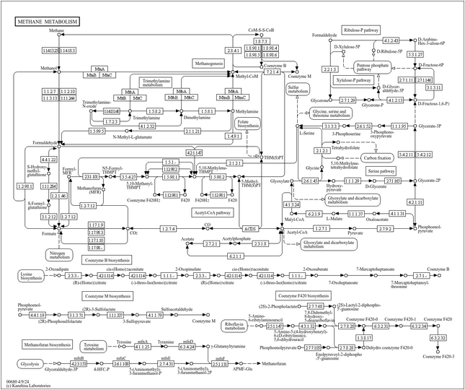
KEGG (Kyoto Encyclopedia of Genes and Genomes)
Comprehensive database integrating genomic, chemical and systemic functional information;
Allows to view the results in pathways.
Fig. 2 - Representation of MAP00680 in KEGG.

Slide 5
KEGGCharter
Command line interface;
Easy to use;
Tool designed to overlay the differential gene expression and taxonomic information of enzymes on KEGG metabolic maps;
Based on Biopython.

Slide 6
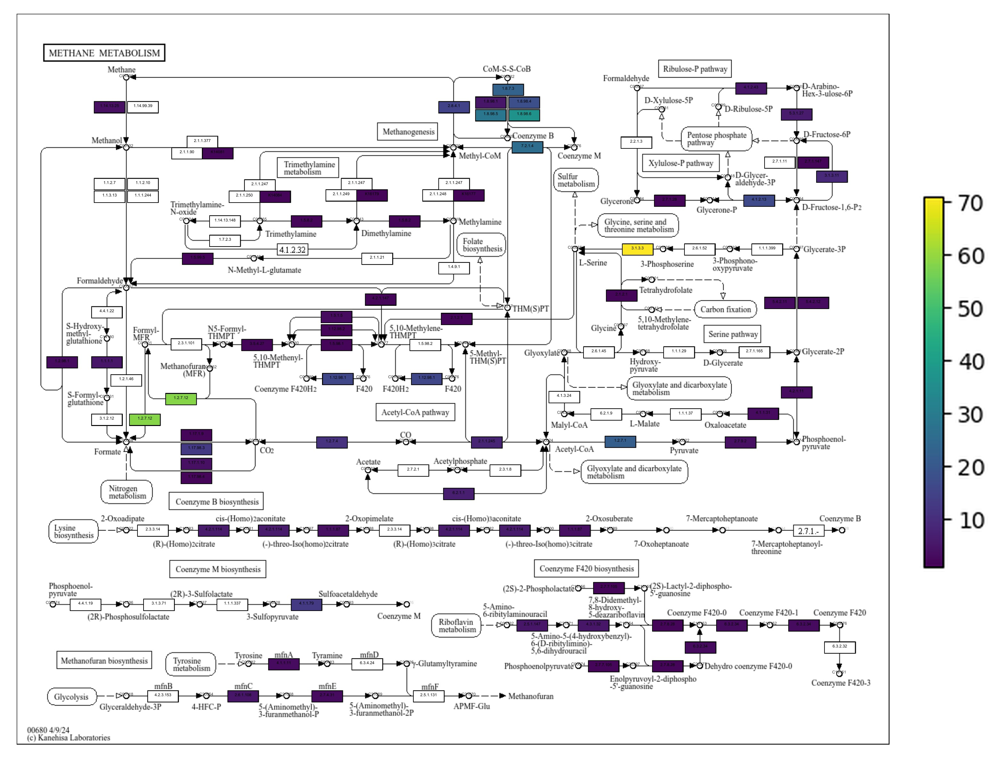
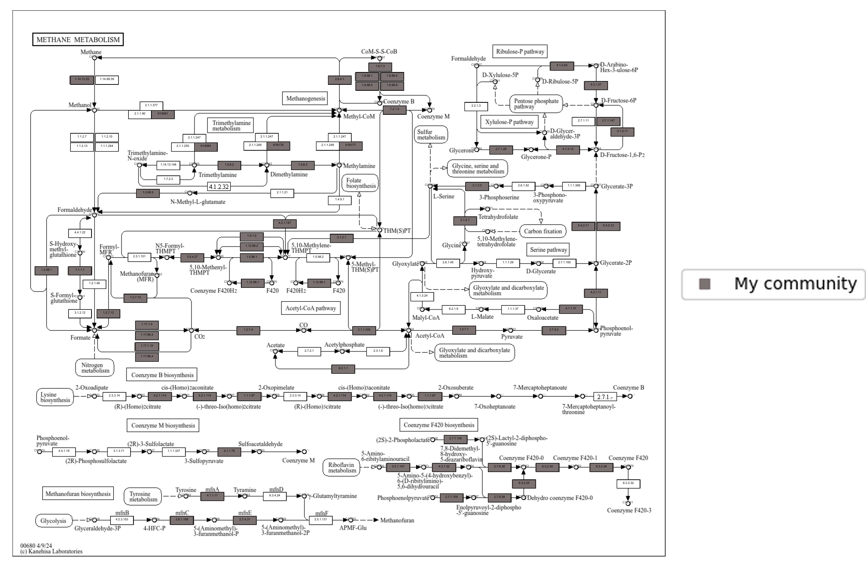
Fig. 3 - KEGG metabolic map of methane metabolism, with differential analysis of quantified expression for each function from a simulated dataset.
Fig. 4 - KEGG metabolic map of methane metabolism, with identified taxa for each function from a simulated dataset.

Slide 7
Objective of this project
Expand the KEGGCharter graphs to include multi-level representation of gene expression information;
Development of new interactive representations on top of the graphs currently produced, to allow more information to be included in metabolic maps, combining taxonomy and expression levels in the same graph.

Slide 8
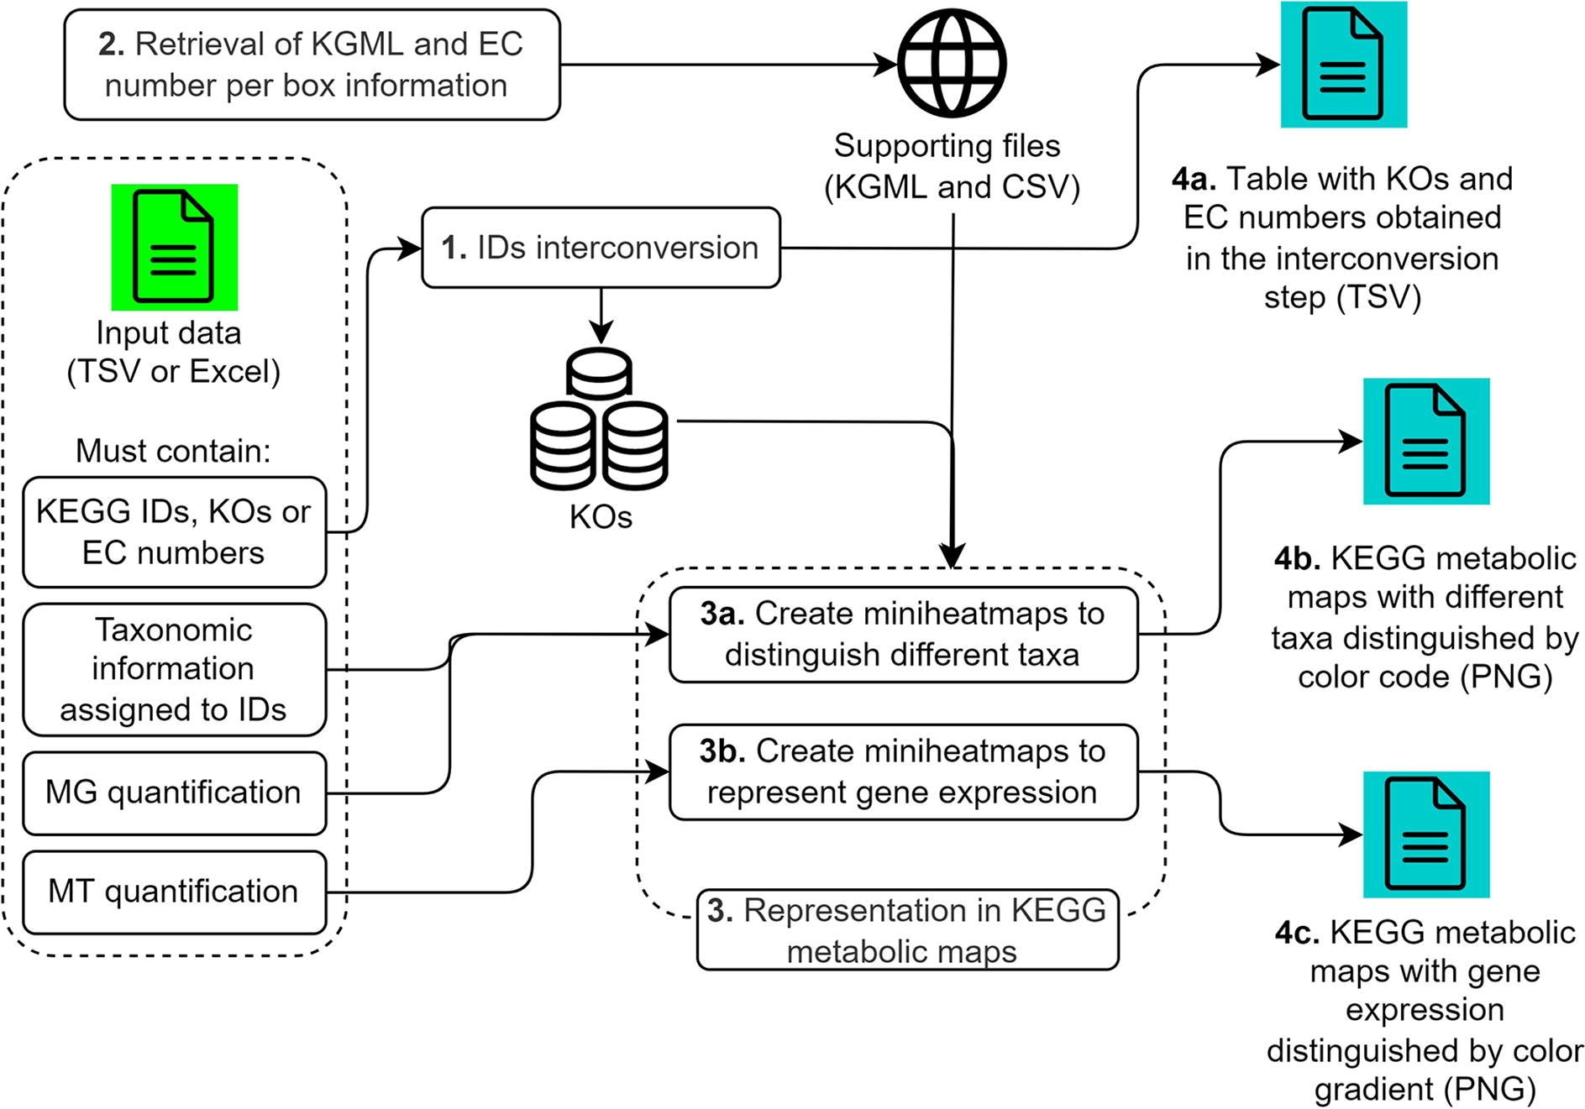
KEGGCharter’s Workflow
Source: [1] UPIMAPI, reCOGnizer and KEGGCharter: Bioinformatics tools for functional annotation and visualization of (meta)-omics datasets.

Slide 9
Project management to date

Slide 10

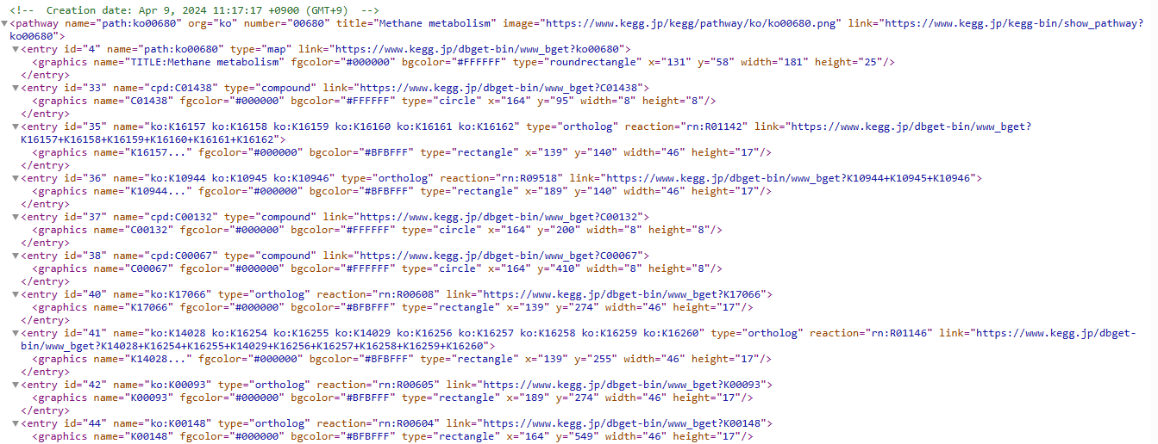
Step 1: Run KEGGCharter to see the outputs;
KGML
Two PNG Maps (differential; potential)

Slide 11
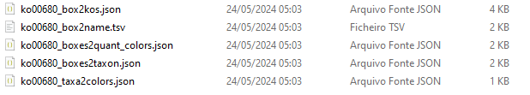
Step 2: Through modifications to the tool, generate new results;
Box id and KOs;
Box id and EC number or KO;
Taxon and colors;
Box id and taxon;
Box id and colors.

Slide 12
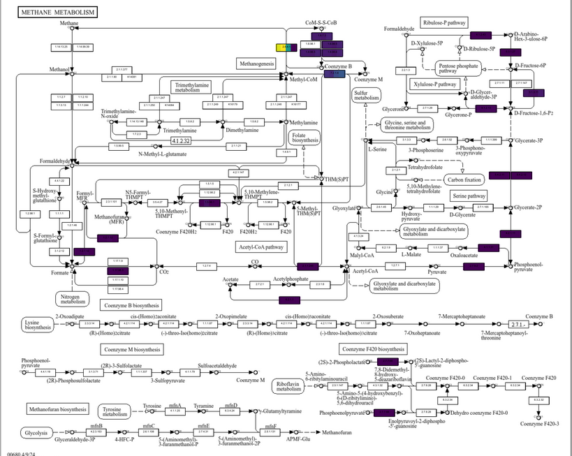
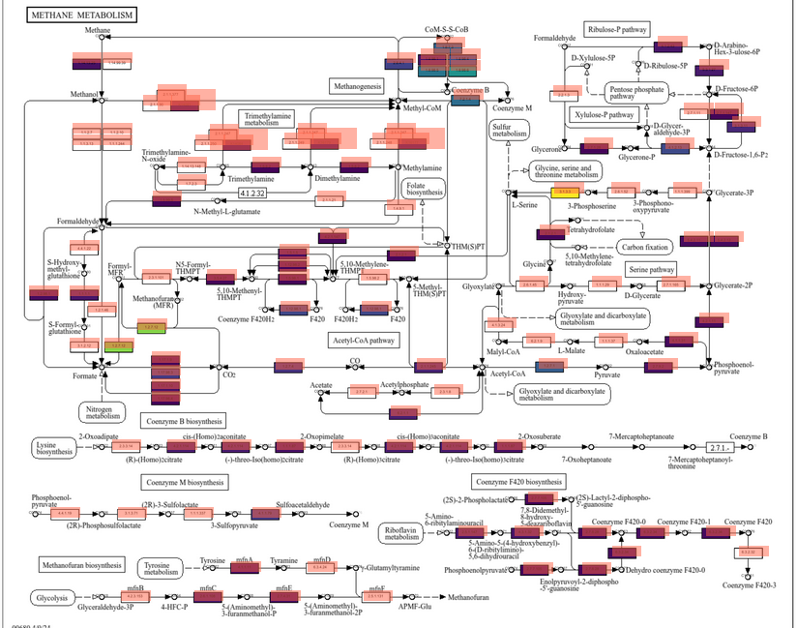
Step 3: Make the png images clickable/ interactive;

Slide 13
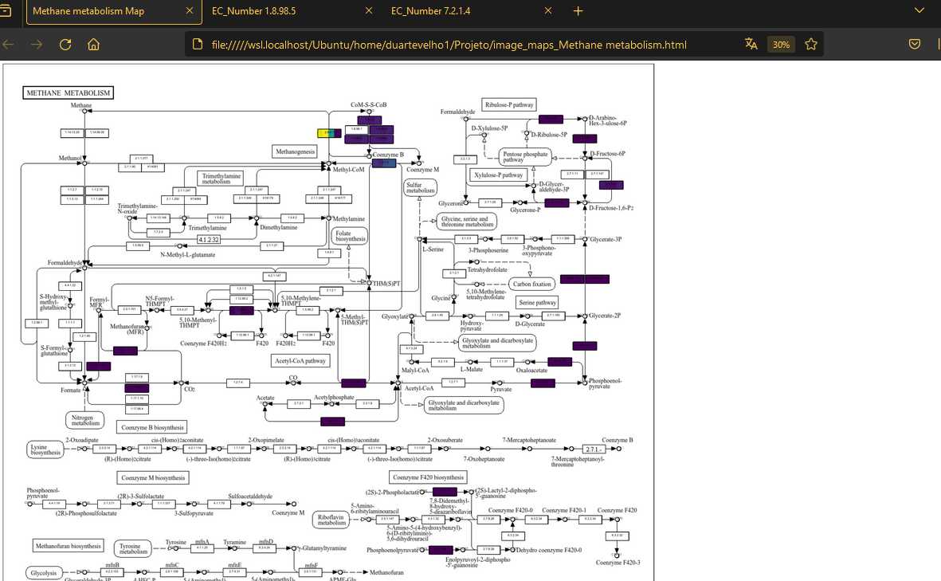
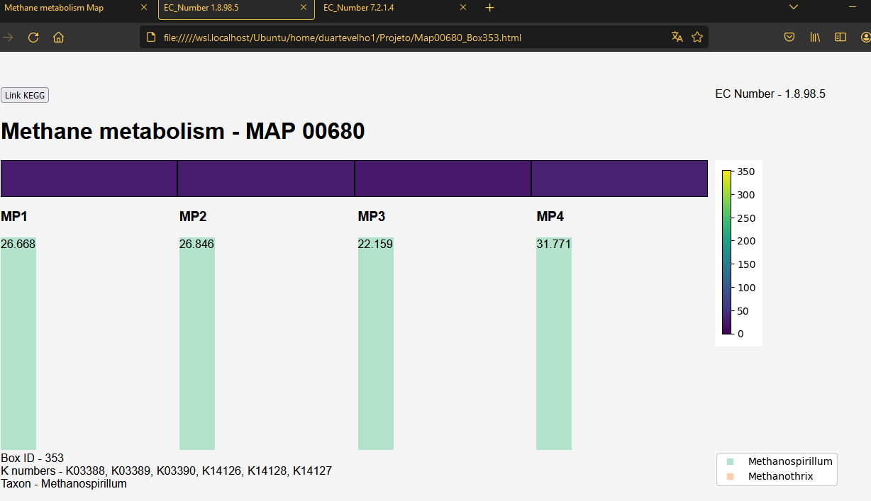
Step 4: Create dynamic html pages for each map box;

Slide 14
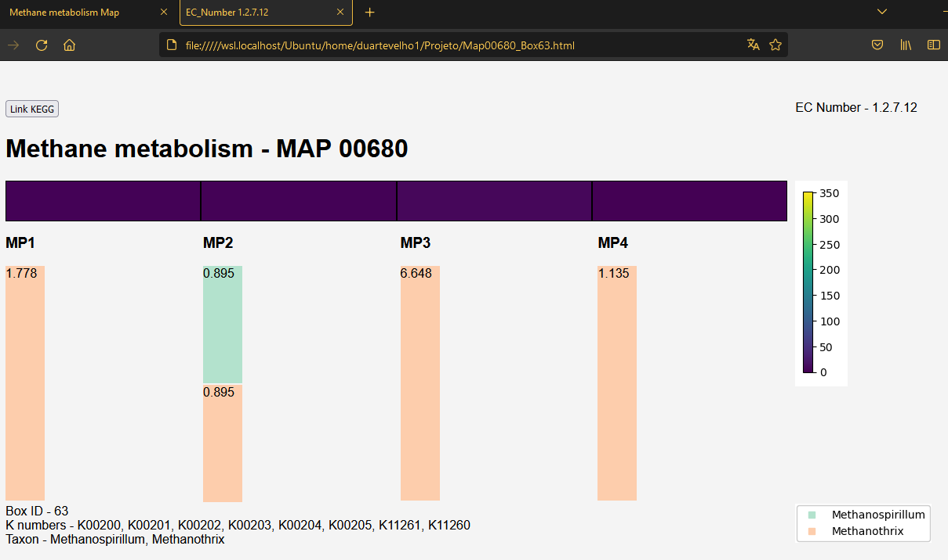
Step 5: Enrich the html pages with relevant information.
What's new: We were able to represent a new quantification, associated with taxonomy (until now it didn't exist)

Slide 15
Summary
Step 1: Run KEGGCharter to see the outputs;
Step 2: Through modifications to the tool, generate new results;
Step 3: Make the png images clickable/interactive;
Step 4: Create dynamic html pages for each map box;
Step 5: Enrich the html pages with relevant information.

Slide 16


Slide 17
Bibliography
[1] Sequeira, J.C., Rocha, M., Alves, M.M., Salvador, A.F.: UPIMAPI reCOGnizer and KEGGCharter: Bioinformatics tools for functional annotation and visualization of (meta)-omics datasets. Comput. Struct. Biotechnol. J. 20, 1798–1810 (2022).
Dennis Jr, G., Sherman, B.T., Hosack, D.A., Yang, J., Gao, W., Lane, H.C., & Lempicki, R.A.: DAVID: Database for Annotation, Visualization, and Integrated Discovery. Genome Biology 4(9), R60 (2003).
Haw, R., Hermjakob, H., D’Eustachio, P., & Stein, L. (2011). Reactome pathway analysis to enrich biological discovery in proteomics data sets. Proteomics, 11(18), 3598–3613.
Funahashi, A., Matsuoka, Y., Jouraku, A., Morohashi, M., Kikuchi, N., Kitano, H.: CellDesigner 3.5: A Versatile Modeling Tool for Biochemical Networks. Proceedings of the IEEE 96(8), 1254–1265 (2008). https://doi.org/10.1109/JPROC. 2008.925458.
Salomonis, N., Hanspers, K., Zambon, A.C., Vranizan, K., Lawlor, S.C., Dahlquist, K.D., Doniger, S.W., Stuart, J., Conklin, B.R., Pico, A.R.: GenMAPP 2: new features and resources for pathway analysis. BMC Bioinformatics 8, 217 (2007).

